Slide 1


SNIPE TEAM
2 January 2018
www.snipe.co.in
1
Notes:
1

Slide 2

TYPESCRIPT

Slide 3
CONTENTS
INTRODUCTION
HISTORY
WHAT IS TYPESCRIPT
WHY WE USE
FEATURES
TS & ECMASCCRIPT
COMPONENTS OF TS
ENVIRONMENT SETUP
BASIC SYNTAX
COMPILE & EXE
EXAMPLE
DECLARING VARIABLES WITH VAR,LET AND CONST
DIFFERENCE BETWEEN VAR LET AND CONST
ADDING TYPE ANNOTATIONS
ARRAY

Slide 4
CONTENTS
TUPLES
ENUM
VOID
CLASSES
FUNCTIONS
Functions Parameters and Return Types
Arrow Functions
Arrow Functions for Different Parameters
Optional Parameters
Default Parameters
Rest Parameters
MODULES
CONCLUSION

Slide 5
INTRODUCTION
TypeScript is a typed superset of JavaScript that compiles to plain JavaScript.
TypeScript is pure object oriented with classes, interfaces and statically typed like C# or Java.
The popular JavaScript framework Angular 2.0 is written in TypeScript.
Mastering TypeScript can help programmers to write object-oriented programs and have them compiled to JavaScript, both on server side and client side.

Slide 6

HISTORY
Anders Hejlsberg, lead architect of C# worked on the development of TypeScript.
TypeScript was first made public in October 2012 (at version 0.8), after two years of internal development at Microsoft.
On 22 September 2016, TypeScript 2.0 was released.

Slide 7
WHAT IS TYPE SCRIPT
What is TypeScript?
TypeScript is a strongly typed, object oriented, compiled language.
TypeScript is both a language and a set of tools.
In other words, TypeScript is JavaScript plus some additional features.
TYPESCRIPT
JAVASCRIPT

Slide 8
WHY USE TYPESCRIPT?
The benefits of TypeScript include −
Compilation − JavaScript is an interpreted language. TypeScript will compile the code and generate compilation errors, if it finds some sort of syntax errors. This helps to highlight errors before the script is run.
Strong Static Typing − JavaScript is not strongly typed. TypeScript comes with an optional static typing and type inference system through the TLS (TypeScript Language Service). The type of a variable, declared with no type, may be inferred by the TLS based on its value.
TypeScript supports Object Oriented Programming concepts like classes, interfaces, inheritance, etc.

Slide 9
FEATURES
Features of TypeScript
TypeScript is just JavaScript. TypeScript starts with JavaScript and ends with JavaScript. Typescript adopts the basic building blocks of your program from JavaScript. Hence, you only need to know JavaScript to use TypeScript. All TypeScript code is converted into its JavaScript equivalent for the purpose of execution.
TypeScript supports other JS libraries. Compiled TypeScript can be consumed from any JavaScript code. TypeScript-generated JavaScript can reuse all of the existing JavaScript frameworks, tools, and libraries.
JavaScript is TypeScript. This means that any valid .js file can be renamed to .ts and compiled with other TypeScript files.
TypeScript is portable. TypeScript is portable across browsers, devices, and operating systems. It can run on any environment that JavaScript runs on. Unlike its counterparts, TypeScript doesn’t need a dedicated VM or a specific runtime environment to execute.

Slide 10
FEATURES
Features of TypeScript
Provides Static Typing - Its lot easier to catch incorrect data type is passing, either by tooling or by compilation process.
Encapsulation - through Classes and Modules. For people who comes from java, c, c++ it will be lot easier.
Supports Interface, where JavaScript doesn’t interface natively.
Arrow Functions (lambda) – It’s a kind of thing from ECMA script ,now its supported by Typescript.

Slide 11
TYPESCRIPT AND ECMASCRIPT
The ECMAScript specification is a standardized specification of a scripting language. There are six editions of ECMA-262 published. Version 6 of the standard is codenamed "Harmony". TypeScript is aligned with the ECMAScript6 specification.
TypeScript adopts its basic language features from the ECMAScript5 specification, i.e., the official specification for JavaScript. TypeScript language features like Modules and class-based orientation are in line with the EcmaScript 6 specification. Additionally, TypeScript also embraces features like generics and type annotations that aren’t a part of the EcmaScript6 specification.
ECMA
SCRIPT 6
ECMA
SCRIPT 5
Additional
Features
TYPESCRIPT

Slide 12
ENVIRONMENT SETUP
Local Environment Setup
Typescript is an Open Source technology. It can run on any browser, any host, and any OS. You will need the following tools to write and test a Typescript program −
A Text Editor
The text editor helps you to write your source code. Examples of a few editors include Windows Notepad, Notepad++, Emacs, vim or vi, etc. Editors used may vary with Operating Systems.
The source files are typically named with the extension .ts

Slide 13
ENVIRONMENT SETUP
The TypeScript compiler is itself a .ts file compiled down to JavaScript (.js) file. The TSC (TypeScript Compiler) is a source-to-source compiler (transcompiler / transpiler).
The TSC generates a JavaScript version of the .ts file passed to it. In other words, the TSC produces an equivalent JavaScript source code from the Typescript file given as an input to it. This process is termed as transpilation.
However, the compiler rejects any raw JavaScript file passed to it. The compiler deals with only .ts or .d.ts files.
app.ts
tsc app.ts
app.js

Slide 14


ENVIRONMENT SETUP
Installing Node.js
Node.js is an open source, cross-platform runtime environment for server-side JavaScript. Node.js is required to run JavaScript without a browser support. It uses Google V8 JavaScript engine to execute code. You may download Node.js source code or a pre-built installer for your platform.
Step 1 − Download and run the .msi installer for Node
Step 2 − To verify if the installation was successful, enter the command node –v in the terminal window.
Step 3 − Type the following command in the terminal window to install TypeScript.
npm install -g typescript

Slide 15
BASIC SYNTAX
Your First TypeScript Code
Let us start with the traditional “Hello World” example −
let message : string = “HelloWorld”;
console.log(message);

Slide 16
js file
var message = "HelloWorld";
console.log(message);

Slide 17
COMPILE AND EXECUTE A TYPESCRIPT PROGRAM
Let us see how to compile and execute a TypeScript program using Visual Studio Code. Follow the steps given below −
Step 1 − Save the file with .ts extension. We shall save the file as Test.ts. The code editor marks errors in the code, if any, while you save it.
Step 2 − Right-click the TypeScript file under the Working Files option in VS Code’s Explore Pane. Select Open in Command Prompt option.
Step 3 − To compile the file use the following command on the terminal window.
Step 4 − The file is compiled to Test.js. To run the program written, type the following in the terminal.
tsc Test.ts
node Test.js

Slide 18
EXAMPLE
Test.ts
class Greeting {
greet():void {
console.log("Hello World!!!")
}
}
var obj = new Greeting();
obj.greet();
Test.js
var Greeting = /** @class */ (function () {
function Greeting() {
}
Greeting.prototype.greet = function () {
console.log("Hello World!!!");
};
return Greeting;
}());
var obj = new Greeting();
obj.greet();

Slide 19
Declaring variables with var,let and const
Let is used to declare variables
Const is used to declare constants
Let a=10;
const allBooks = GetAllBooks();

Slide 20
Difference Between var let and const
Globally available in the
Function in which it is declared
“Hoisted” to the top of the function
Variable name maybe declared a second time in the same function
Only available in the block in which it is declared
Not “hoisted” to the top of the block
Variable name may only be declared once per block

Slide 21


Adding Type Annotations
Boolean
let present : Boolean = true;
Number
String

Slide 22

Adding Type Annotations
Any

Slide 23
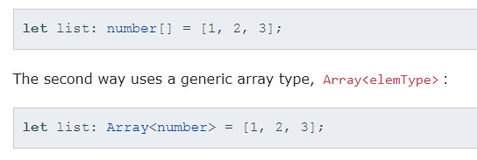
Array
Data storage
To hold a single type of data
Two different ways to declare an array

Slide 24
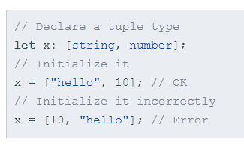
Tuples
Tuples are specialized type of array.
Where you can specify type for first few elements in the array, don’t have to be the same type.
Example

Slide 25
Enum
• Addition to JavaScript datatypes. Similar to C# enum
• Like languages like C#, an enum is a way of giving more friendly names to sets of numeric values.
• By default, enums begin numbering their members starting at 0. You can change this by manually setting the value of one its members.
Ex:- enum Animals{ Dog ,Cat ,Lion ,Tiger } // 0,1,2,3
enum Animals{ Dog=3 ,Cat ,Lion ,Tiger } // 3,4,5,6
enum Animals{ Dog=10 ,Cat=8 ,Lion=0 ,Tiger=7 } //

Slide 26
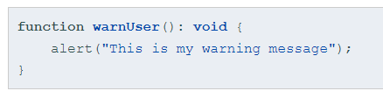
Void
Void is like opposite of any: the absence of having any type at all
You may commonly see this as the return type of functions that do not return a value:

Slide 27
CLASSES
TypeScript is object oriented JavaScript. TypeScript supports object-oriented programming features like classes, interfaces, etc. A class in terms of OOP is a blueprint for creating objects. A class encapsulates data for the object. Typescript gives built in support for this concept called class.
Creating classes
Use the class keyword to declare a class in TypeScript. The syntax for the same is given below −
Syntax:
class class_name {
//class scope
}

Slide 28
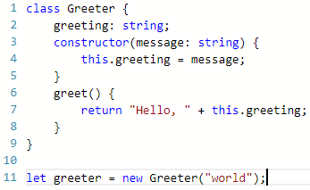
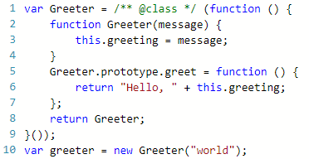
CLASSES

Slide 29
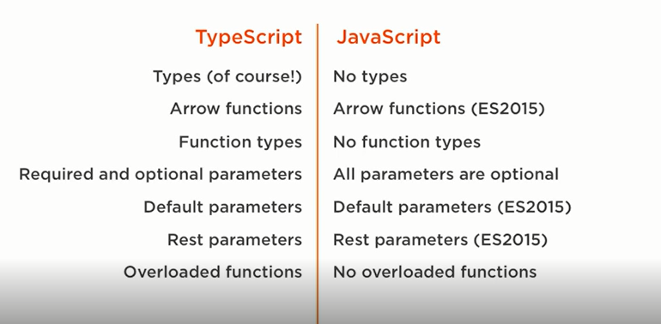
Functions

Slide 30
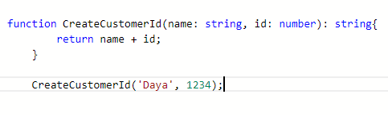
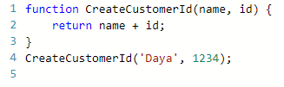
Functions Parameters and Return Types
.ts
.js

Slide 31
Arrow Functions
Normal function
let arr= all.filter(function(book)
{
Console.log(book);
}
All.filter(‘C++’);
Arrow function
body
arr= all.filter(book=>console.log(book);
parameter
body

Slide 32
Arrow Functions for Different Parameters
NO PARAMETER
welcome( () =>console.log(“hello”) );
MULTILPEL PARAMETERS
1. add( (a,b,c) =>console.log(a + b +c) );
2. add((a,b,c)=> {
c = a + b;
console.log(c);
.
.
};
Do more stuff

Slide 33
Optional Parameters
OPTIONAL :
Function CreateCutsomer (name : string , age? : number){ }
CreateCustomer (“Daya” , 25);
CreateCustomer (“Daya”);
Optional Parameters denoted with “?” after parameter name.
Must appear after all required parameters.

Slide 34
Default Parameters
Default :
Function CreateCutsomer (name : “DAYA”, age? : number){ }
CreateCustomer (“Daya” , 25);
CreateCustomer (“Daya”);
Default Parameters may set to literal values or an expression.
Must appear after all required parameters.

Slide 35
Rest Parameters
Default :
Function GetBooks (name: string ,…bookID: number[ ]){ }
let books=GetBooks(‘Book1’,2,5);
let books=GetBooks(‘Book1’,2,5,6,9);
For passing variable number of parameters.
Collects a group of parameters into a single array.

Slide 36
MODULES
A module is designed with the idea to organize code written in TypeScript. Modules are broadly divided into −
Internal Modules
External Modules
Internal Module:
Internal modules came in earlier version of Typescript. This was used to logically group classes, interfaces, functions into one unit and can be exported in another module. This logical grouping is named namespace in latest version of TypeScript.

Slide 37
Internal Module Syntax:
MODULES
namespace snipe community{
export function add(x, y) { console.log(x + y);}
}
JavaScript generated in both cases are same:
var snipe community;
(function (snipe community){
function add(x, y)
{ console.log(x + y);
} snipe community.add = add;
})(snipe community || (snipe community = {}));

Slide 38
MODULES
External Module:
External modules in TypeScript exists to specify and load dependencies between multiple external js files. If there is only one js file used, then external modules are not relevant. Traditionally dependency management between JavaScript files was done using browser script tags (<script></script>).
Syntax-
//FileName : SomeInterface.ts
export interface SomeInterface {
//code declarations
}

Slide 39
MODULES
External Module:
Example
/ IShape.ts
export interface IShape {
draw();
} // Circle.ts
import shape = require("./IShape");
export class Circle implements shape.IShape {
public draw()
{ console.log("Cirlce is drawn (external module)");
}
} // Triangle.ts
import shape = require("./IShape");
export class Triangle implements shape.IShape {
public draw() { console.log("Triangle is drawn (external module)"); }
}
// TestShape.ts
Import shape = require("./IShape");
import circle = require("./Circle");
import triangle = require("./Triangle");
function drawAllShapes(shapeToDraw: shape.IShape) {
shapeToDraw.draw();
}
drawAllShapes(new circle.Circle());
drawAllShapes(new triangle.Triangle());

Slide 40
MODULES
The command to compile the main TypeScript file for AMD systems is −
On compiling, it will generate following JavaScript code for AMD.
File:IShape.js
tsc --module amd TestShape.ts
//Generated by typescript 1.8.10
define(["require", "exports"], function (require, exports) { });

Slide 41
MODULES
File:Circle.js
define(["require", "exports"], function (require, exports) { var Circle = (function () {
function Circle() {
} Circle.prototype.draw = function () {
console.log("Cirlce is drawn (external module)");
};
return Circle;
})();
exports.Circle = Circle;
});

Slide 42
MODULES
File:Triangle.js
define(["require", "exports"], function (require, exports) {
var Triangle = (function () {
function Triangle() {
}
Triangle.prototype.draw=function () {
console.log("Triangle is drawn (external module)");
};
return Triangle;
})();
exports.Triangle = Triangle;
});

Slide 43
CONCLUSION
TypeScript lets you write JavaScript the way you really want to. TypeScript is a typed superset of JavaScript that compiles to plain JavaScript. TypeScript is pure object oriented with classes, interfaces and statically typed like C# or Java. The popular JavaScript framework Angular 2.0 is written in TypeScript. Mastering TypeScript can help programmers to write object-oriented programs and have them compiled to JavaScript, both on server side and client side.

Slide 44
FAQ
FAQ’s

Slide 45
FAQ
What is TypeScript and Why Do We Need It?
What are Different Components of TypeScript?
How Can You Get TypeScript and Install It?
How Do You Compile TypeScript Files?
Is It Possible to Combine.ts Files into a Single Multiple.js File?
Is It Possible to Compile .ts Automatically with Real Time Changes in .ts File?
Which Object Oriented Terms are Supported by TypeScript?
Which are the Different Data Types Supported by TypeScript?
How Do You Implement Inheritance in TypeScript?

Slide 46
FAQ
Which features does TypeScript support natively?
Static typing
All of the above
Classes and modules
Interfaces
Constructors
Support for standard JavaScript code

Slide 47
FAQ
2. Which statement is true about arrow function expressions in TypeScript?
they must contain optional parameters
they must have a void return type
they are the compact form of function expressions
they must omit parameters
3. Interfaces defined in TypeScript are included in the JavaScript that is generated?
a. True
b .false

Slide 48
FAQ
4. External modules are ideal to use when you have:
Both of these
large applications with many modules all in 1 file.
large applications with many modules which have dependencies on each other.
Neither of these

Slide 49
FAQ
5. Which of the following code samples shows the proper way to define a constructor in a TypeScript class?
new(name: string) { }
All of these
constructor(name: string) { }
public constructor(name: string) { }

Slide 50
FAQ
6.Which line of code statically types a variable to be a number and initializes its value?
var number: age = 17;
var age : number = 17;
var age is number = 17;
var age : number;
none of the above

Slide 51
FAQ
7. How do you compile TypeScript code?
Copy your TypeScript code into an online compiler
None of these
Run tsc.exe YourFileName.ts at the command line
Save the .ts file in any editor and code will automatically be compiled

Slide 52
FAQ
8.Which of the following is not a type keyword in TypeScript?
Float
Bool
Number
all are valid types in TypeScript
string

Slide 53
FAQ
9. Which TypeScript function will accept 2 parameters that must be numbers and return their product?
var func = (x, y) => x * y;
var func = function(x, y) => x * y;
None of these
var func = (x: number, y: number) => x * y;

Slide 54
THANK YOU

